Slide 1
Invention Innovation Creativity
2094 Week 7 Tutorial

Slide 2

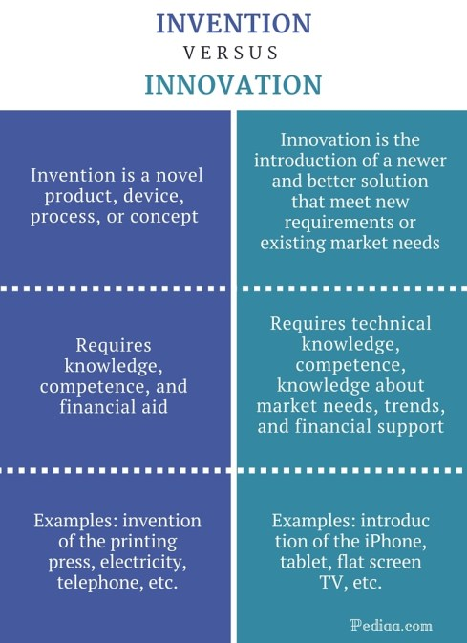
Invention VS Innovation
Let’s understand the difference
Pay attention to the economic value

Slide 3
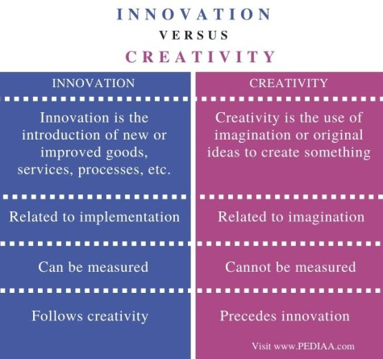
Creativity VS Innovation
Remember which one follows the other
In which ways they are useful in organizations?

